Slide 1
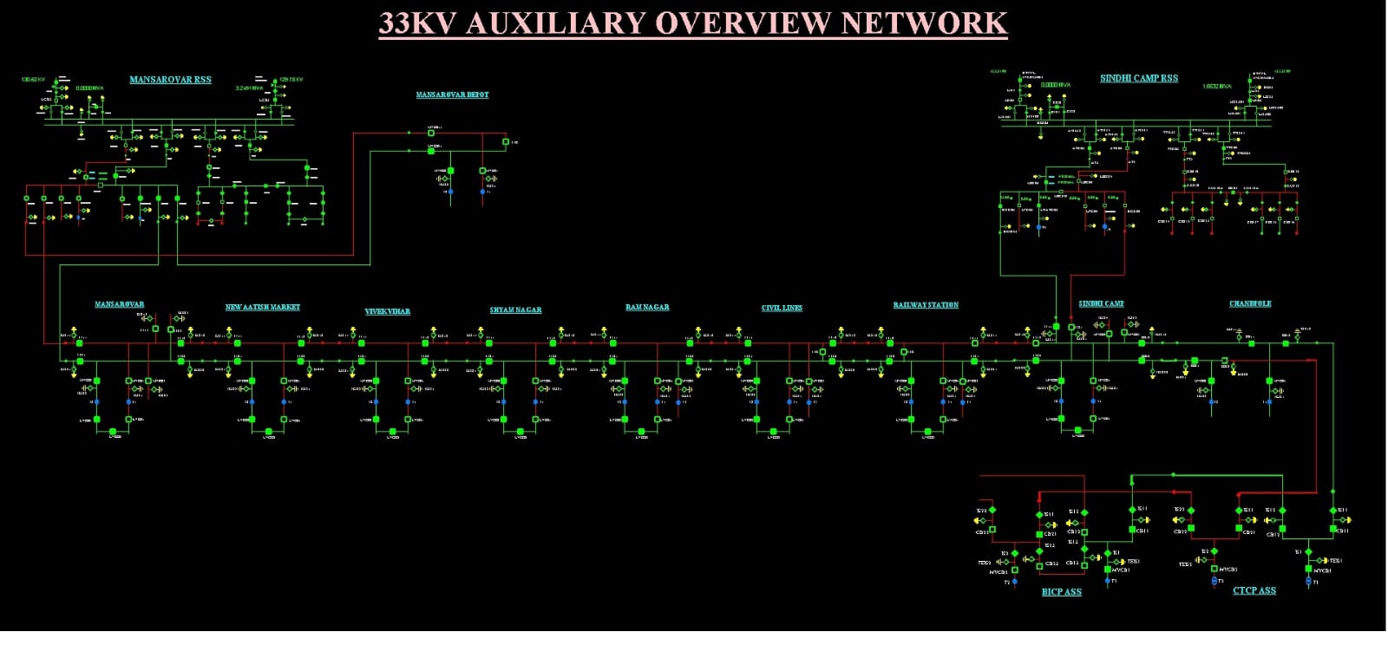
SCADA JMRC
Harshit saha
Mohd. Adnan
Adityaraj singh Shekhawat
Under the guidance of :-
Mr. KK sharma
DGM(S & T)
Dr. Usha Choudhary
professor

Slide 2
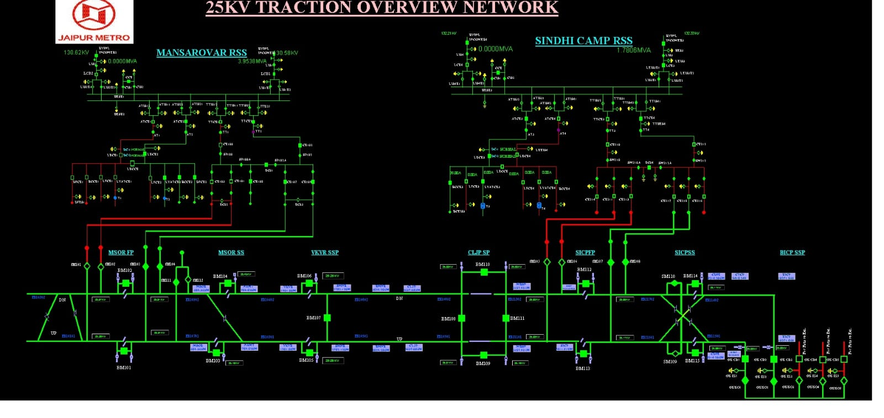
SCADA
Introduction
Features
overview
challenges
Conlusion

Slide 3
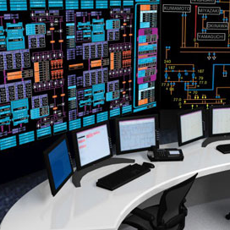
Introduction
In today's world of modern industrial control and monitoring systems, there exists a crucial element that we refer to as Supervisory Control and Data Acquisition (SCADA) software. Its purpose is to lend a helping hand to organizations in monitoring, controlling, and optimizing numerous industrial processes, ultimately guaranteeing efficient and reliable operations.
This software is equipped with the ability to merge real-time data acquisition, visualization, and control functionalities, presenting valuable insights and control over critical processes to operators. In our composition, we will take a closer look at the crucial components, advantageous perks, and diverse applications of SCADA software.

Slide 4
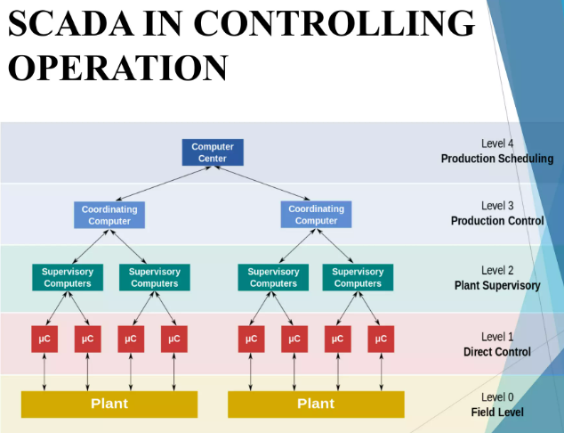
Features of scada
SCADA software comes with some essential elements, such as:
1. Supervision:
Supervision of the traction and auxiliary power system interactively with schematic pictures which illustrate the real time status of CB, Isolators, PT etc. and direct the operator to make correct decisions.
2. Interface:
A user-friendly interface that allows operators to quickly and easily access data from multiple devices.

Slide 5
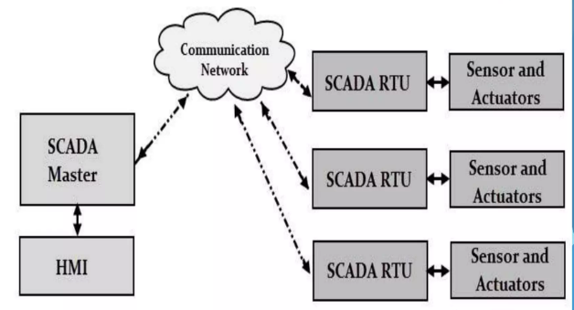
Features of scada
3. Data acquisition:
Process information is stored on a process database and a report database in the form of event list, energy reports and graphs.
4. Control:
The operator performs control operations like open or close the CB, isolators etc.
5. Security:
Secure access controls and encryption to protect data and prevent unauthorized access.

Slide 6
Need for scada
SAVING OF MAN-POWER
FASTER RESTORATION OF POWER SUPPLY
EASY FAULT SEGREGATION OF TRACTION SYSTEM
FAULT ANALYSIS THROUGH GRAPHS
STORAGE OF DATA

Slide 7
Micro scada 9.3
Micro SCADA is a programmable and distributed SCADA system. It is microcomputer-based, which means it runs on almost every available PC. All Micro SCADA applications and most of its configuration programs are built using SCIL (Supervisory and Control Implementation Language), a programming language used only in Micro SCADA. Micro SCADA is mainly designed for substation automation and process industry applications .

Slide 8
Main components of scada
1. Supervisory (Computer ) System : Base system -Servers, software (SCADA , operating system)
2. HMI – Human Machine Interface : Controller Workstations
3. RTUs- Remote Terminal Units
4. Communication network between RTUs & Server System

Slide 9
Working of scada
SCADA system is mainly divided into three parts :
Remote Terminal unit
Communication system
The software/hardware part at Operation control centre
Software(OCC): Micro SCADA 9.3
Window : Window 2007(Server pack1), 32 bit
RSS Software: SUI V1.1.0 ( SLD View)
SCE V4.85.06 ( Editing SLD)
Window : Window server 2008 , 32 bit

Slide 10
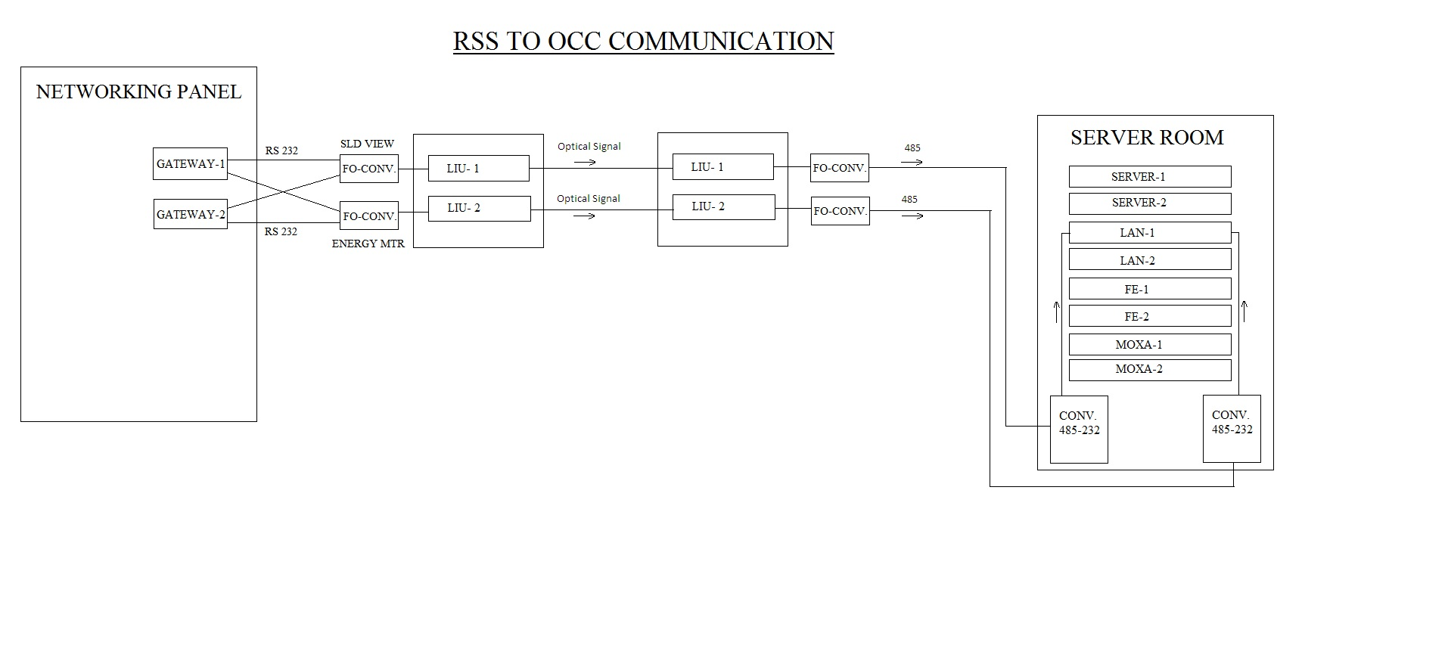

Slide 11
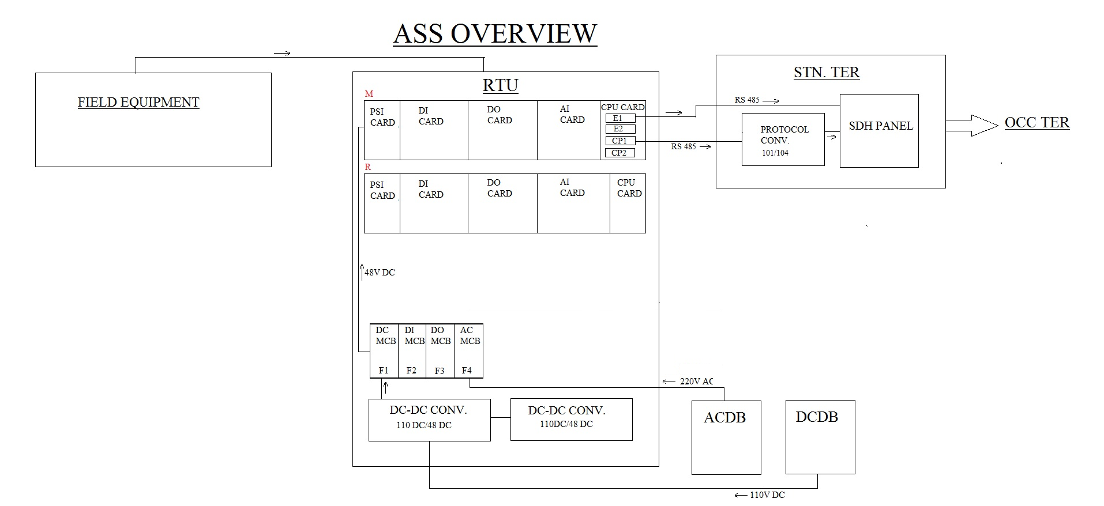

Slide 12
Protocol used
IEC-870-5-101 protocol used for SCADA.
IEC 61850 protocol used for SAS (RSS SCADA).

Slide 13
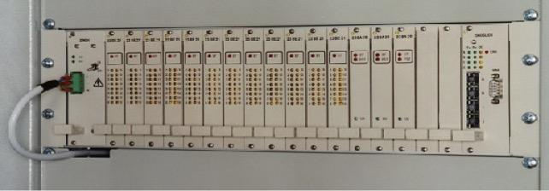
Remote terminal unit
1. It operates on 110V.
2. There are Two converters (DC-DC converter) which is used to convert 110V DC to 48V DC.
Cards Comprising RTU :-
DIGITAL INPUT CARD (For Monitoring of status)
DIGITAL OUT-PUT CARD (For Command execution)
ANALOG INPUT CARD (For Measurement of analog values)
CPU CARD (For data processing and comm)
POWER SUPPLY CARD (5 V and 24V for RTU working)

Slide 14
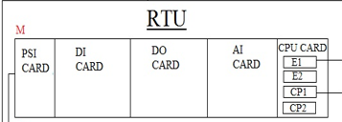
Working of rtu
PSI – It convert 48V to three different voltage (24V,19V,5V)
In which 24V,19V works for relay operation and remaining 5V works for Led. DI -It indicate whether the braker is closed or open. When Breaker got command then it will open or close the braker. When Breaker got Closed - Green When Breaker got Open - White DO – It used for controlling the breakers.
AI – It Store the measurement of Voltage, Frequency and Current
CPU card contains four ports
1. E1 – Ethernet port – 1 Not Fourth Protocol
2. E2 – Ethernet port
3. CP1 – Serial communication
4. CP2 – Serial communication

Slide 15
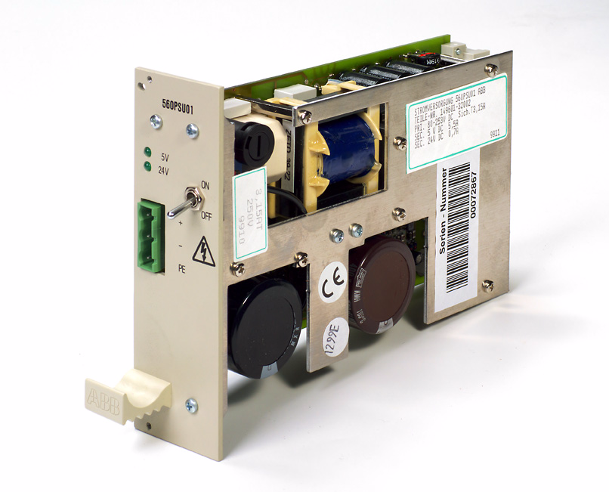
POWER SUPPLY CARD
This card is used for power supply of RTU.
The 560PSU001 board converts 48V to 5V and 24V.

Slide 16
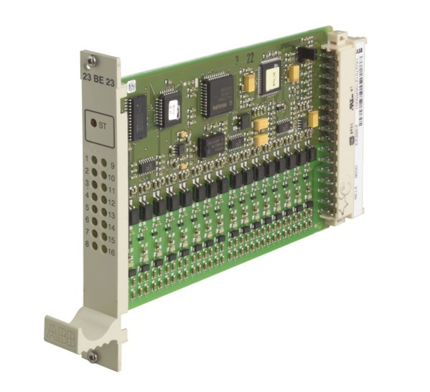
DIGITAL INPUT CARD
The binary input board 23BE23 is used for 16 binary process signals.
Potential free contacts (NO/NC) of breaker are used to take status of the equipment.
The board has sixteen light emitting diodes to indicate the signal state.
LED ON Digital State = 1
LED OFF Digital State = 0

Slide 17
DIGITAL INPUT CARD
Two Types of Indication :
Single Indication : Single Contact is used
Double Indication : It is used only for close/open status.
1 0 Close
0 1 Open
0 0 Intermediate
1 1 Faulty

Slide 18
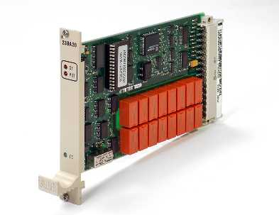
DIGITAL OUTPUT CARD (23BA20)
Binary Output Board 23BA20
This card is used to execute close/open command to the circuit breakers,isolators etc.
Total 16 Nos. Command can be executed from one card .
ST : common malfunction information of the board.
PST : Processor error.
CO : Command output display during output time.

Slide 19
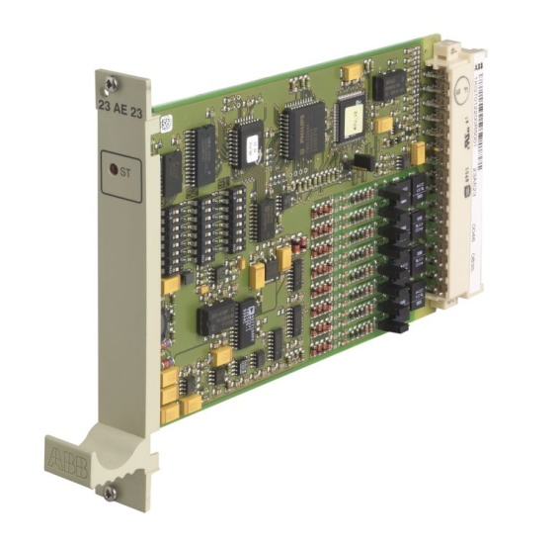
ANALOG INPUT CARD 23AE23
This card is used to measure voltage,
current, frequency.
Total 8 Nos. signals can be measured from one card .

Slide 20
SUPERVISION
Separate picture for every sub-station (RSS,TSS,AMS,ASS and 25KV control post)
Coloaration Logic :
Green : Charged
Red : No supply
Yellow : Earthed

Slide 21
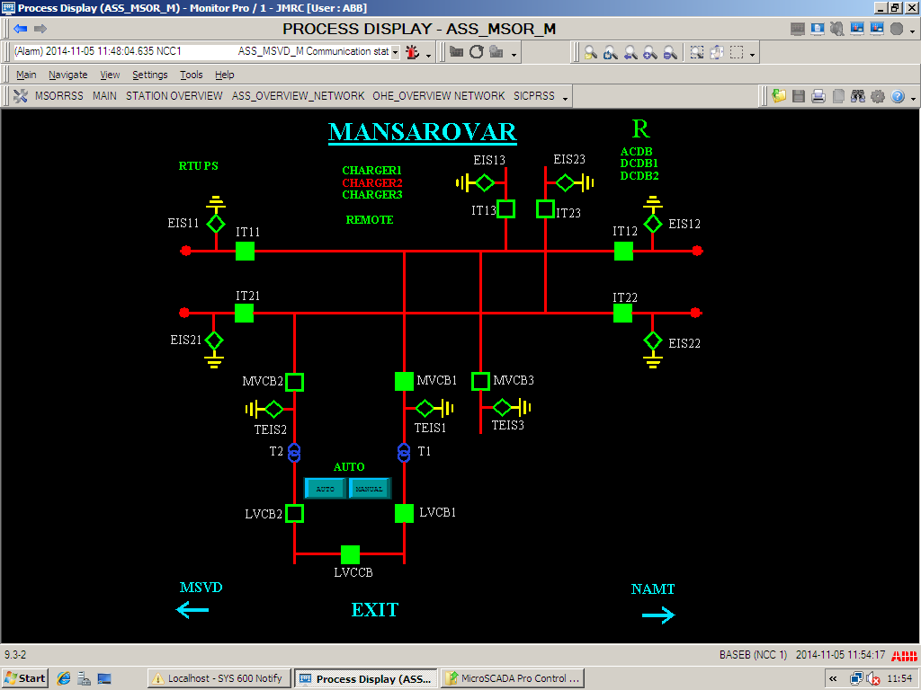

Slide 22
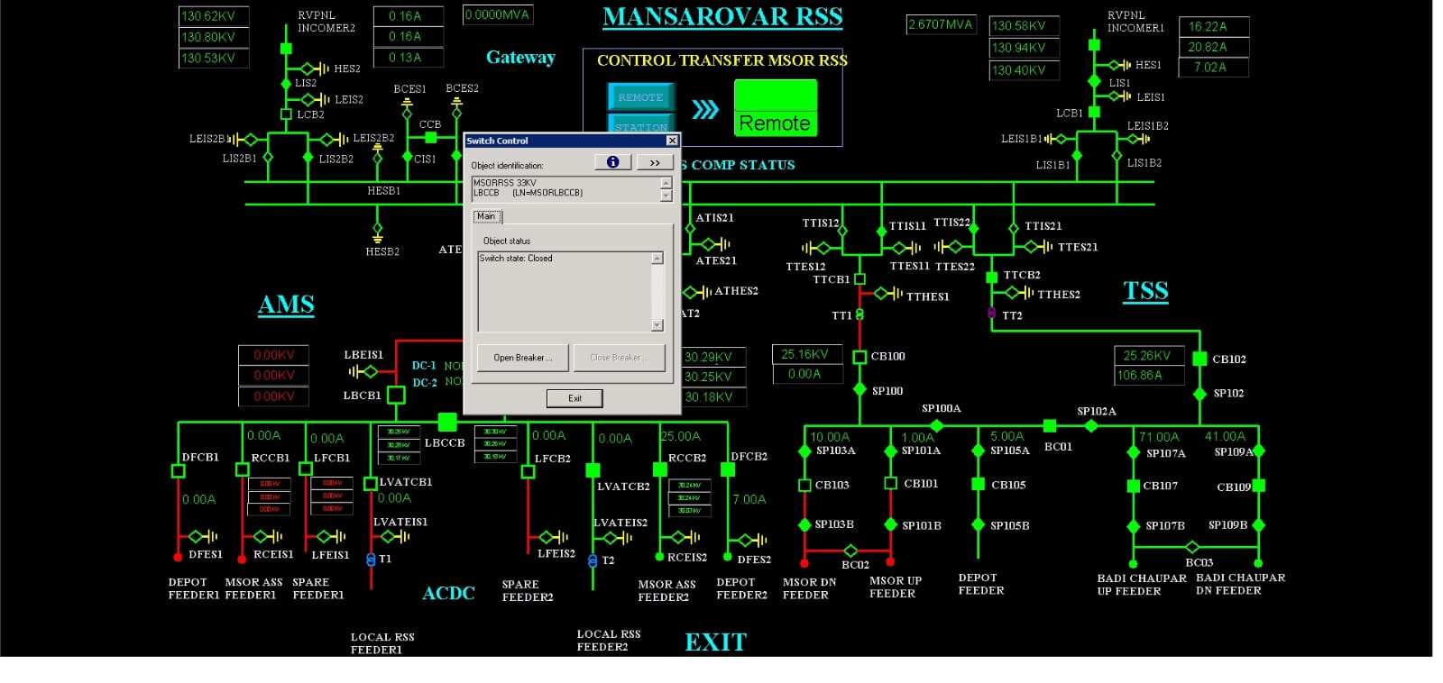
Open/close switch

Slide 24
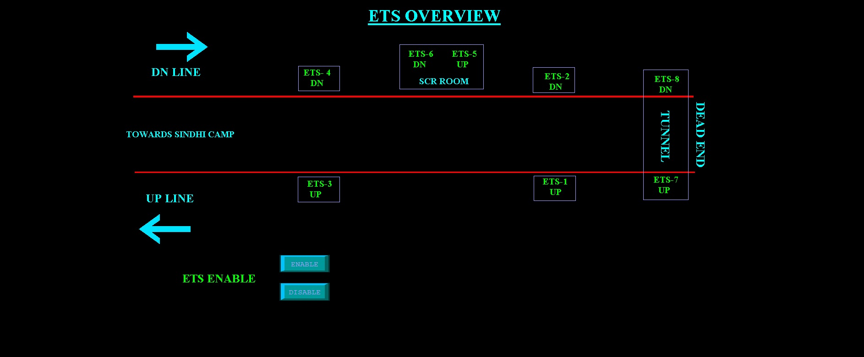

Slide 25
conclusion
On our visit to OCC(Operation Control Centre) of JMRC where the Jaipur Metro SCADA (Supervisory Control and Data Acquisition) system is situated, various issues were confronted by SCADA systems that could be problematic for the Jaipur Metro SCADA system. Some of these complications are as follows:
1. Cybersecurity - Robust cybersecurity measures must be implemented to protect SCADA systems from various cyber threats like hacking attempts, unauthorized access, and malware. Firewalls, regular system updates, and encryption are crucial components of cybersecurity that must be ensured to maintain the integrity and security of the system.
2. Reliability - Any disruptions to metro operations can lead to inconvenience and safety concerns, so it is crucial for SCADA systems to be highly reliable. System failures and downtime should be prevented at all costs to ensure continuous operation and control of critical infrastructure.

Slide 26
conclusion
3. Different Company Equipment - Among different subsystems, such as power supply, signaling, and communication networks, SCADA systems require communication and data exchange. The task of making sure there is seamless integration and interoperability can be complicated.
4. Annual Maintenance Contract - Regular maintenance is necessary to keep the SCADA system operating at an optimal level and avoid downtime. To achieve this, it's important to provide training to the team responsible for its maintenance and operation. Additionally, updating and troubleshooting activities must be conducted regularly.
The SCADA system needs to be able to expand as Jaipur Metro grows, with the addition or alteration of lines, stations, and equipment. Technical and logistical difficulties may arise when trying to upgrade and extend the system.

Slide 27


Thank you
Harshit Saha
Mohd adnan
Adityaraj singh shekhawat

